Slide 1
Jitterbug
Pauline Dang

Slide 2
Jitter
Jitter is small intermittent delays during data transfers
Can be cause by congestion, collisions, and signal interference, etc.
Jitter is a type of latency
Can be problematic for real-time applications

Slide 3
Challenges in Network Congestion
RTT time series can detect network anomalies, like congestion
The problem lies in distinguishing congestion from the rest
Auto-correlation-based methods can help infer recurring congestion
But there isn’t a way to detect one-off congestion events
Round-trip time is the duration in milliseconds it takes for a network request to go from a starting point to a destination and back again to the starting point
RTT can be used to identify improved latency
One of the factors that can affect RTT is congestion

Slide 4
Analyzing RTT and Jitter Signatures in Congested Links
We look a the periodicity, amplitude, and variability of RTT to characterize the nature of path anomalies
Periodicity captures events that recur and a fixed frequency and duration
Amplitude measures the degree of changes in RTT from a baseline
Variability refers to the stability of RTT during period of increased activity

Slide 5
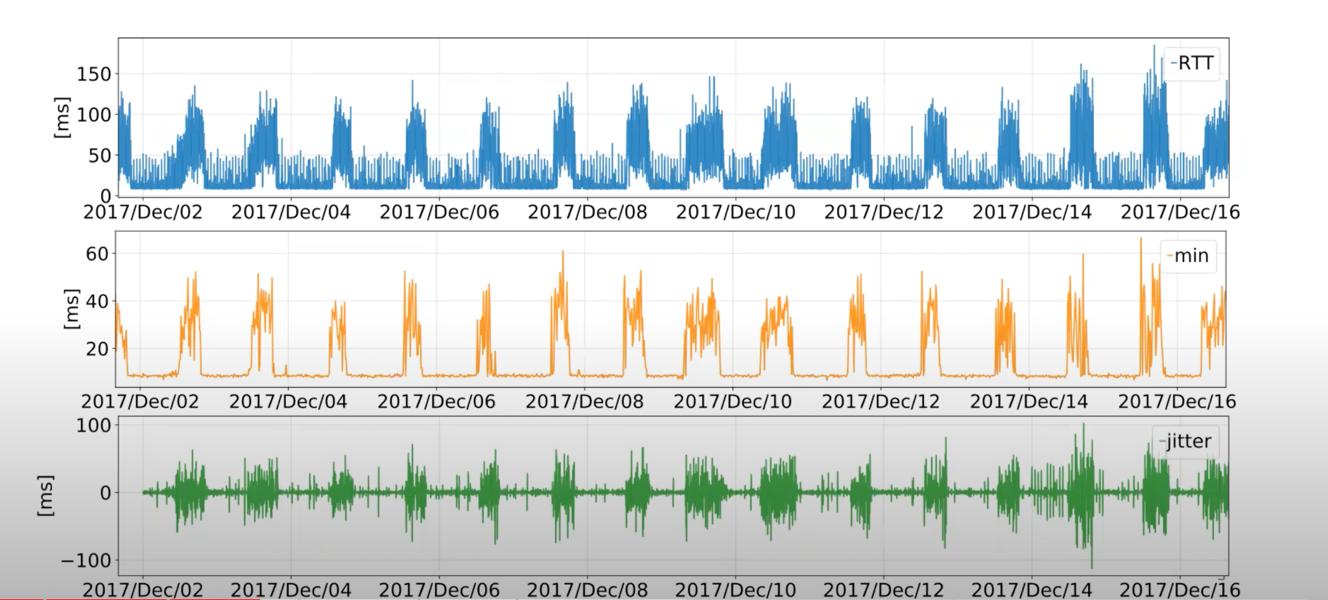
Here we see that there is a strong correlation between jitter and minimum of time series over recurrent latency.
Latency is an expression of how much time it takes for a data packet to travel from one point to another

